Slide 1
Energy Saving

Slide 2
Energy Saving
Saving energy at home is important because it helps the environment and can lower your bills. Here are some simple tips you can follow

Slide 3
1. Turn Off Lights: When you leave a room, always remember to turn off the lights. This can save a lot of energy!
2. Use Energy-Efficient Bulbs: Switch to LED bulbs. They use less electricity and last much longer than regular bulbs.

Slide 4
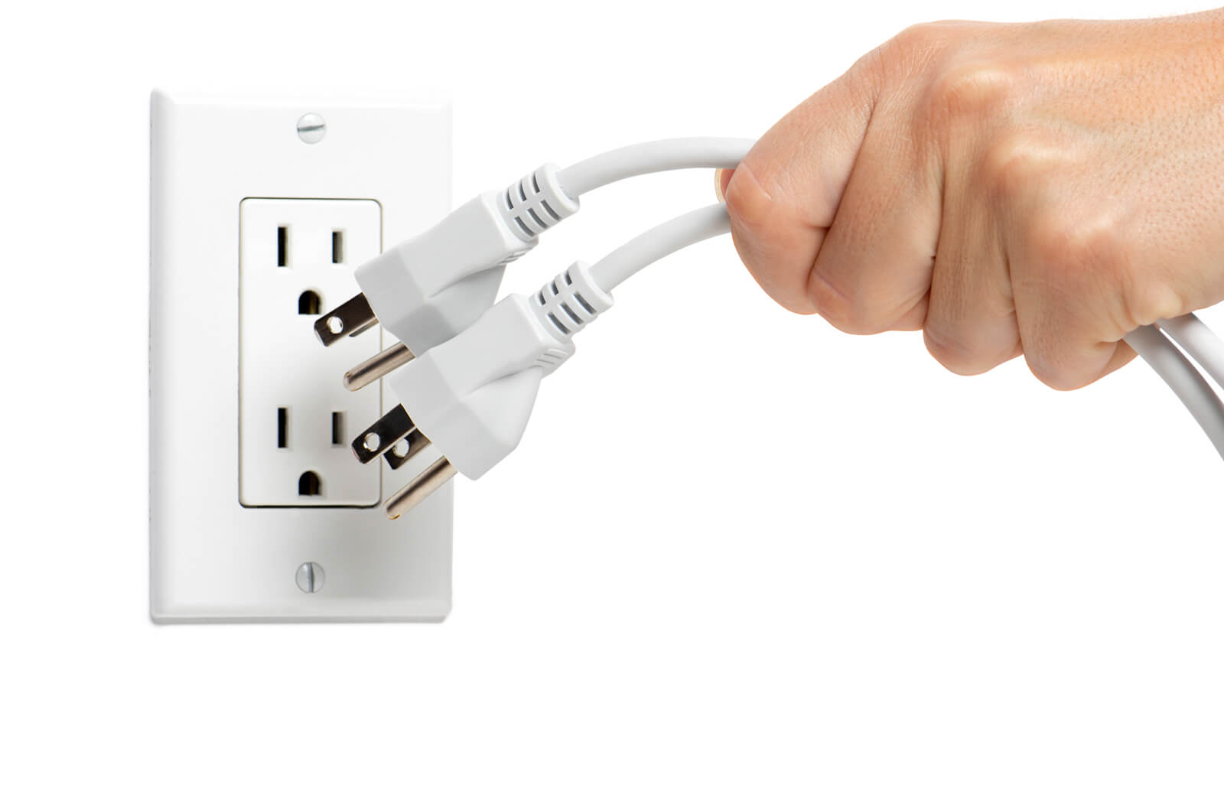
3.Unplug Devices: Many devices still use energy even when they’re turned off. Unplug chargers and electronics when you’re not using them

Slide 5

4. Use Natural Light: Open your curtains during the day instead of turning on lights. Sunlight is free and brightens up your home!

Slide 6

5. Adjust Your Thermostat: In winter, set your thermostat a little lower and wear warmer clothes. In summer, set it a bit higher and use fans instead of air conditioning.

